Slide 1




1
Introduction to Microsoft Excel
Prepared By :
Said Fawzy
Manager of Information Center
Tendering Department
Arab Contractors

Slide 2

1
Excel User Interface
2
Entering and formatting data
3
Working with rows and columns
4
Working with worksheets

Slide 3
1
Excel User Interface

Slide 4


Slide 5
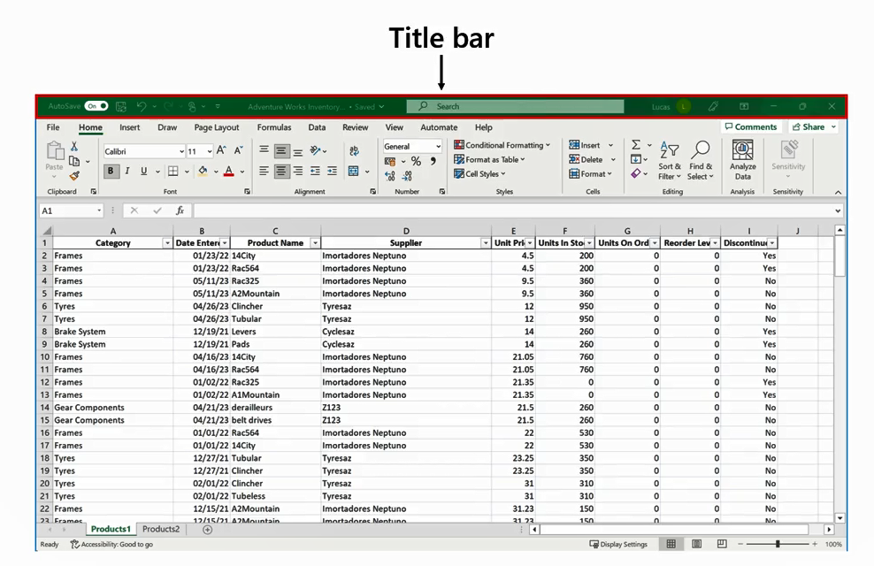

Slide 6
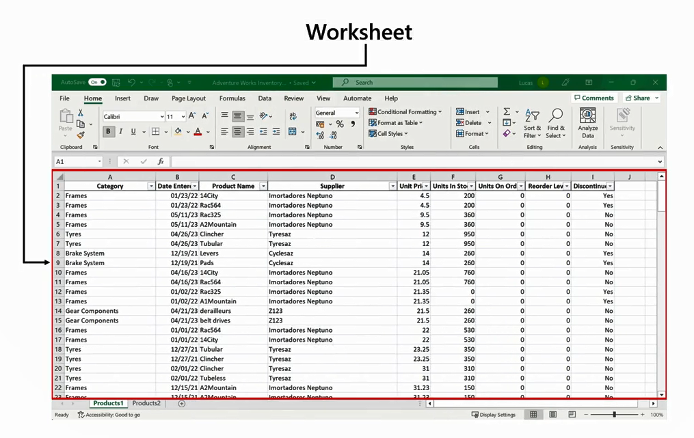

Slide 7
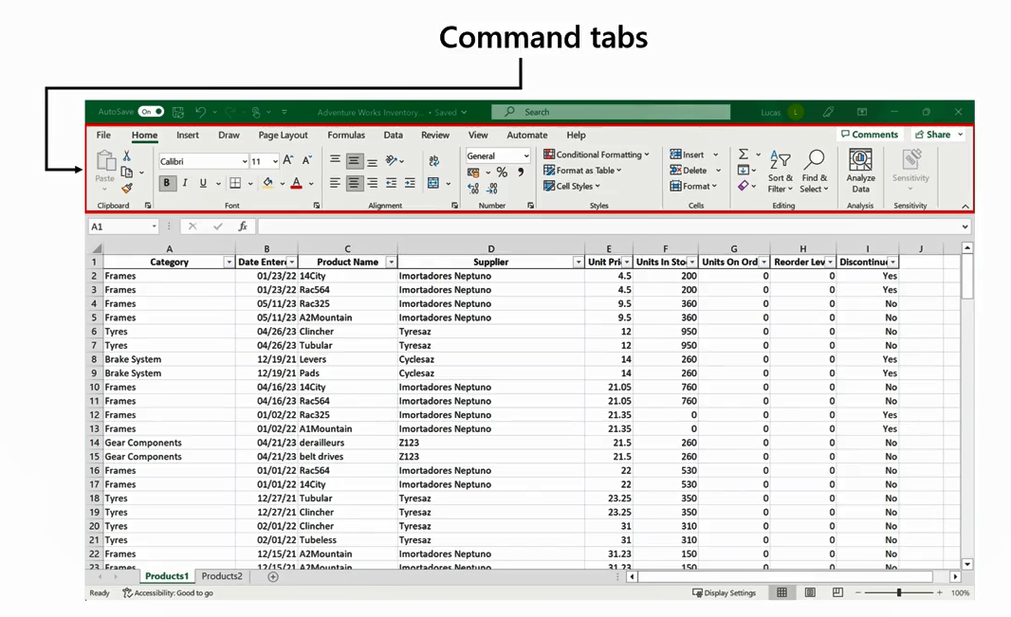

Slide 8
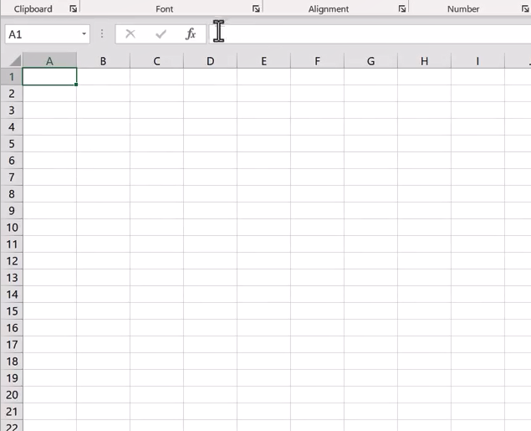
The Grid
Columns
Formula Bar
Rows
Cell

Slide 9
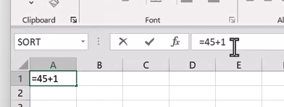
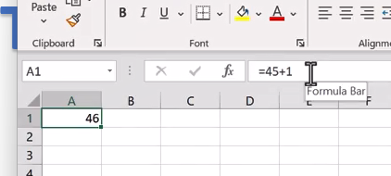
The Grid
Formula Bar always shows
the actual content

Slide 10
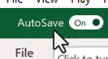
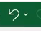
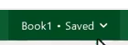
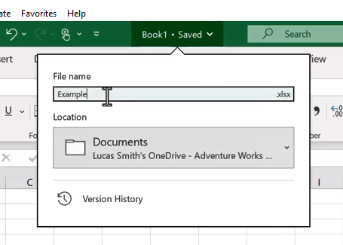
Title Bar
Undo
File name up to 255
(recommended 31)

Slide 11
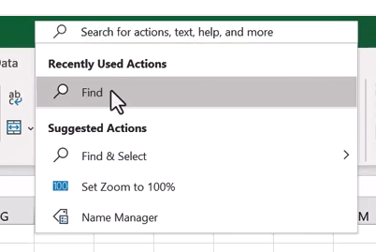
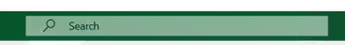
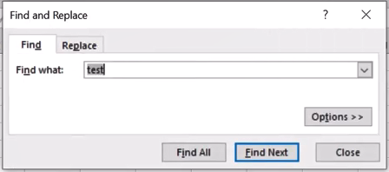
Title Bar

Slide 12
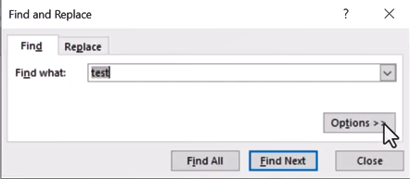
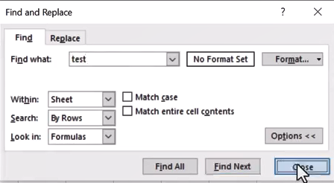
Title Bar

Slide 13
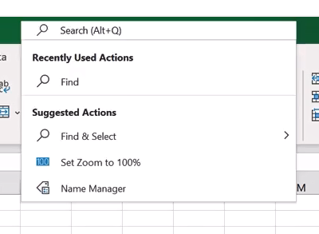
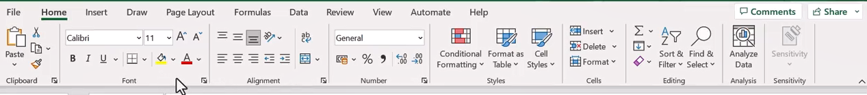
Title Bar
Recently Used Actions

Slide 15
Home

Slide 16
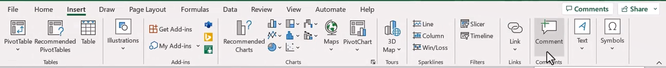
Insert

Slide 17
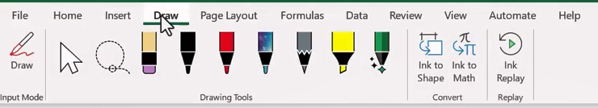
Draw

Slide 18
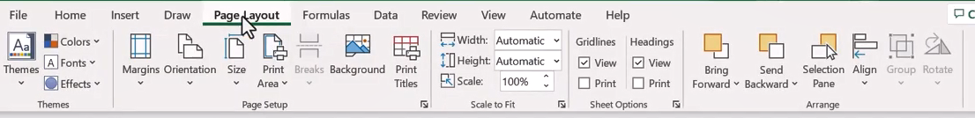
Page layout

Slide 19
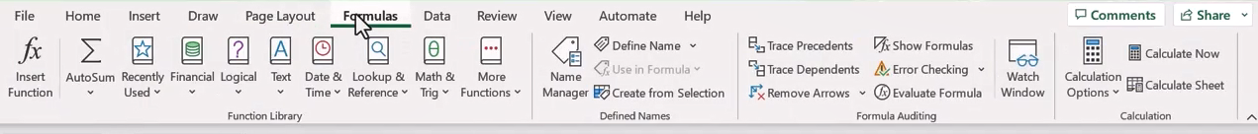
Formula

Slide 20
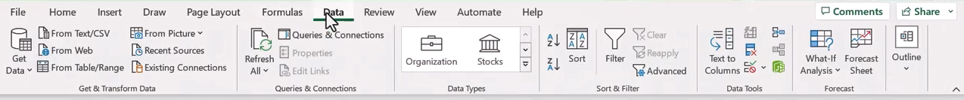
Data

Slide 21
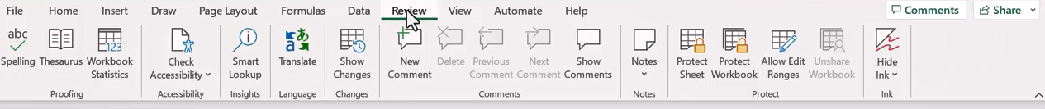
Review

Slide 22
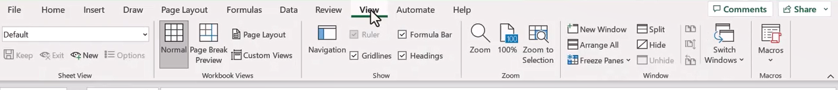
View

Slide 23
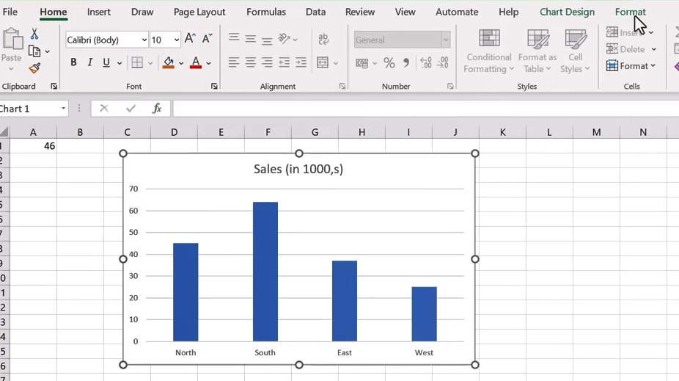
Contextual Tabs

Slide 24
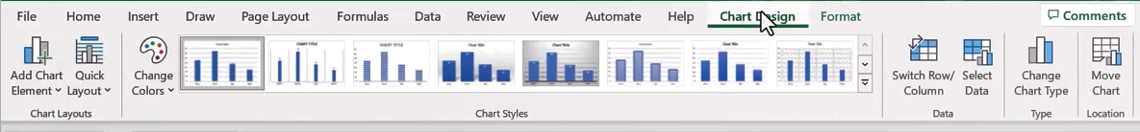
Contextual Tabs

Slide 25
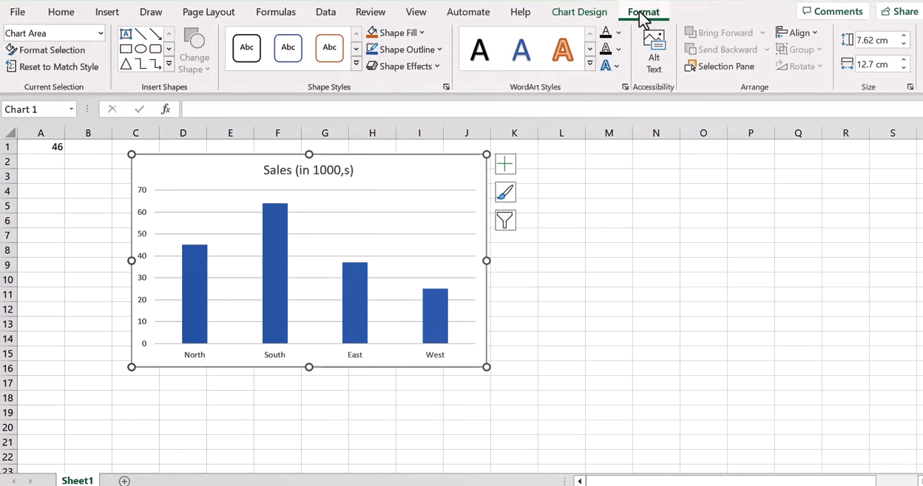
Contextual Tabs

Slide 26

Question 1-1
You attempt to rename an Excel file to Customer’s first/last name and address. However, Excel rejects this name. Can you identify the reason why Excel won’t accept this name?
The filename contains prohibited punctuation marks.
The filename contains too many characters.
The filename contains several spaces.

Slide 27

Question 1-1
You attempt to rename an Excel file to Customer’s first/last name and address. However, Excel rejects this name. Can you identify the reason why Excel won’t accept this name?
The filename contains prohibited punctuation marks.
The filename contains too many characters.
The filename contains several spaces.

Slide 28
2
Entering and formatting data
3

Slide 29

Demo 1 A
Entering and formatting Data

Slide 30
Question 1-2
You want to quickly add the department name Customer Service in cells C1 to C20. You decide to use the Autofill feature. What type of mouse pointer shape do you need to Autofill?
A narrow white hand shape.
A narrow white cross shape.
A narrow black cross shape.

Slide 31
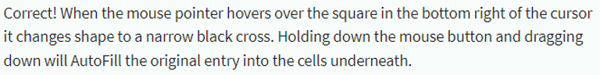
Question 1-2
You want to quickly add the department name Customer Service in cells C1 to C20. You decide to use the Autofill feature. What type of mouse pointer shape do you need to Autofill?
A narrow white hand shape.
A narrow white cross shape.
A narrow black cross shape.

Slide 32
3
Working with rows and columns

Slide 33
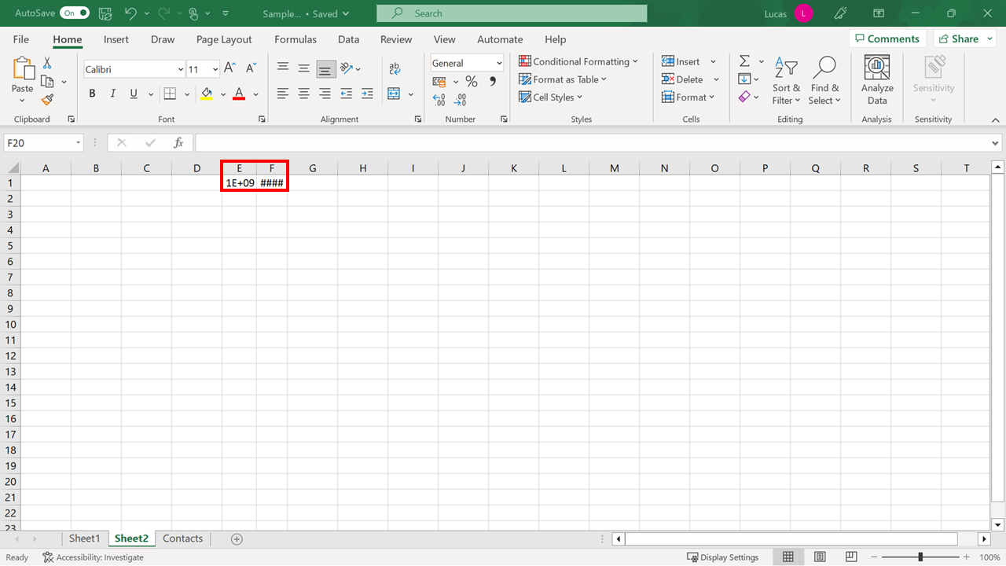
Resizing Columns
Resizing Columns

Slide 34
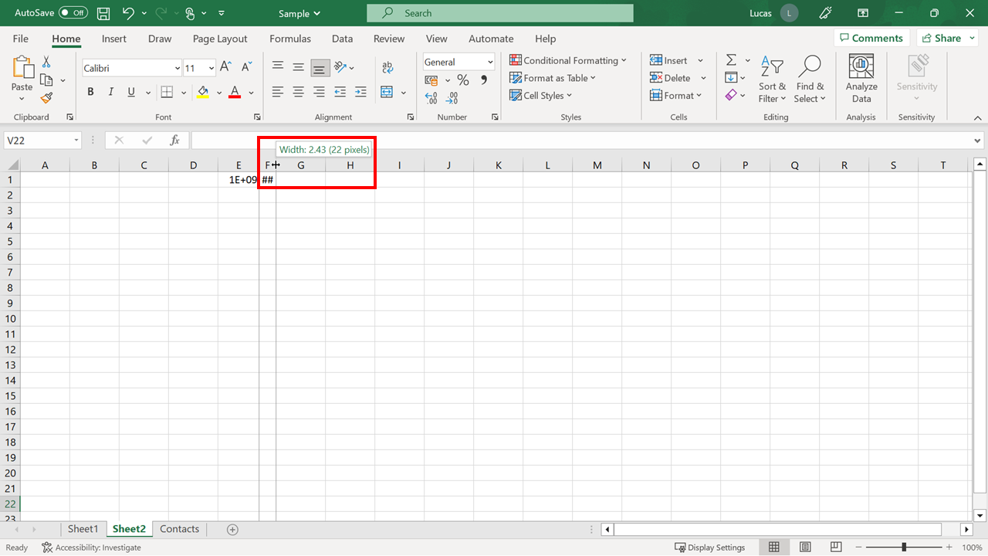
Resizing Columns

Slide 35
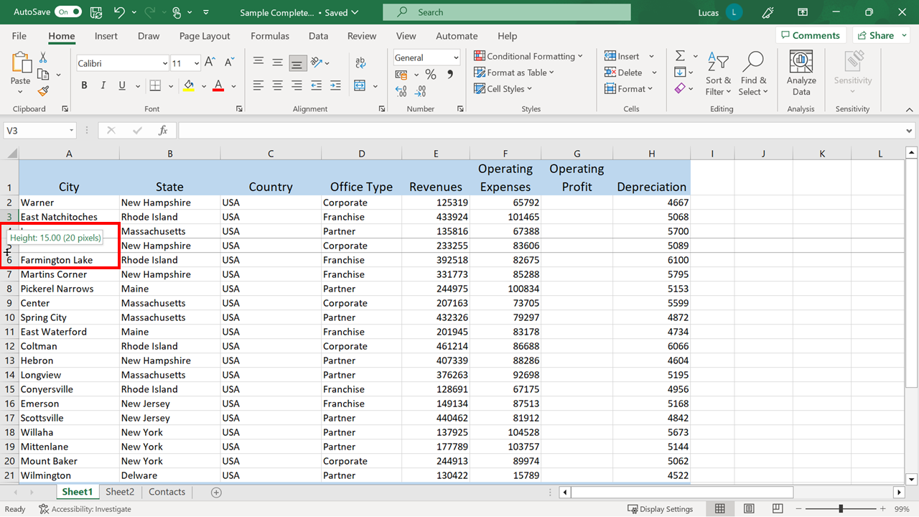
Change Depth of Row

Slide 36
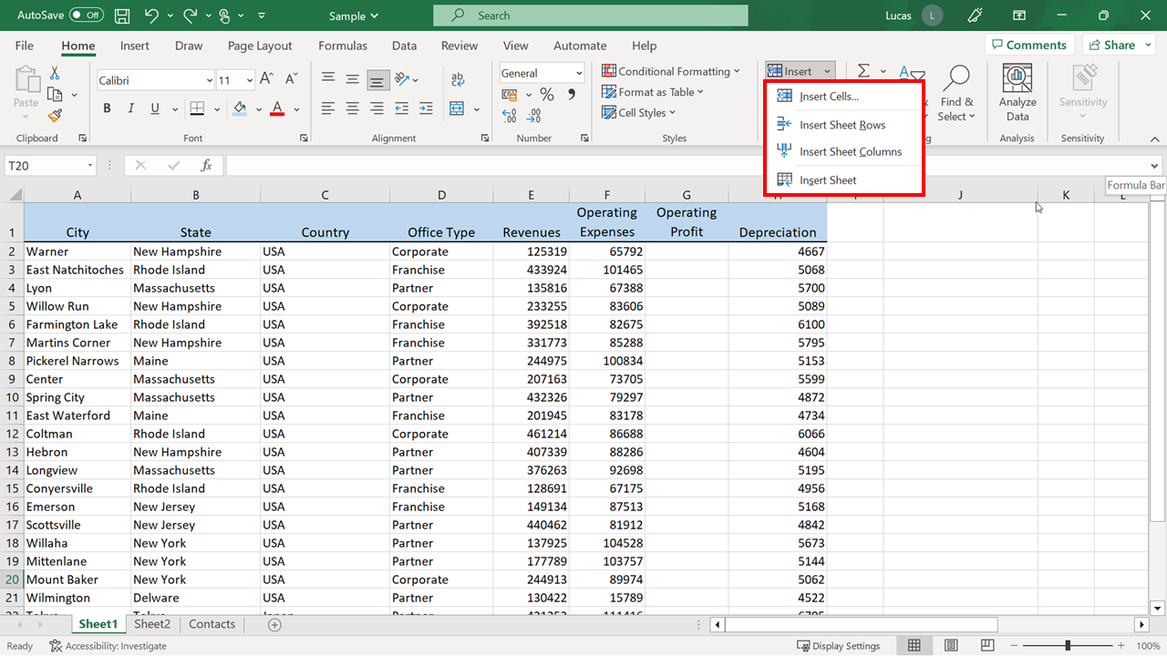
Inserting columns

Slide 37
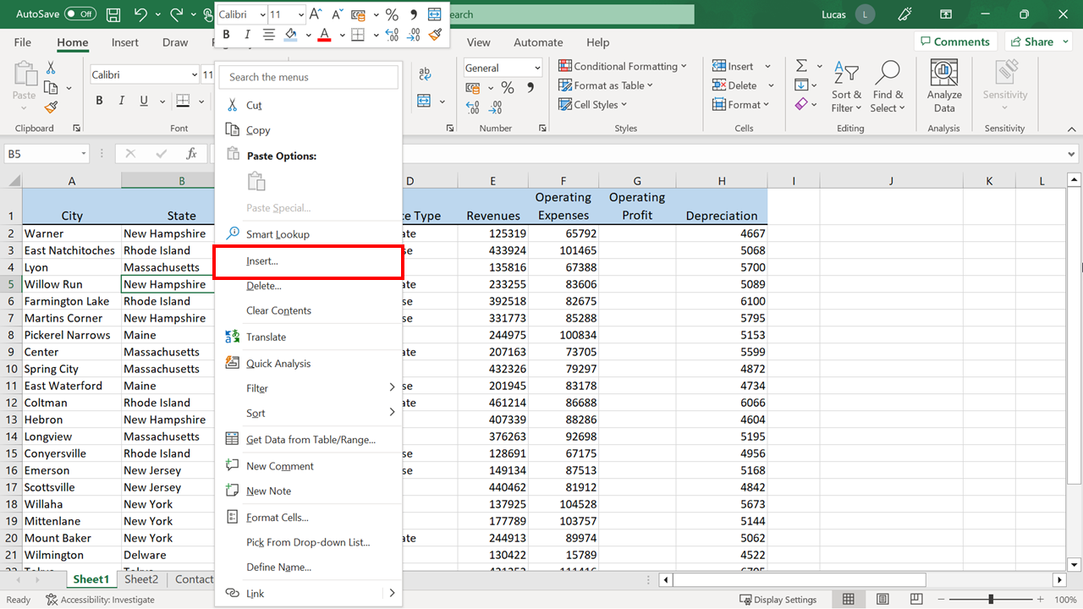
Inserting columns

Slide 38
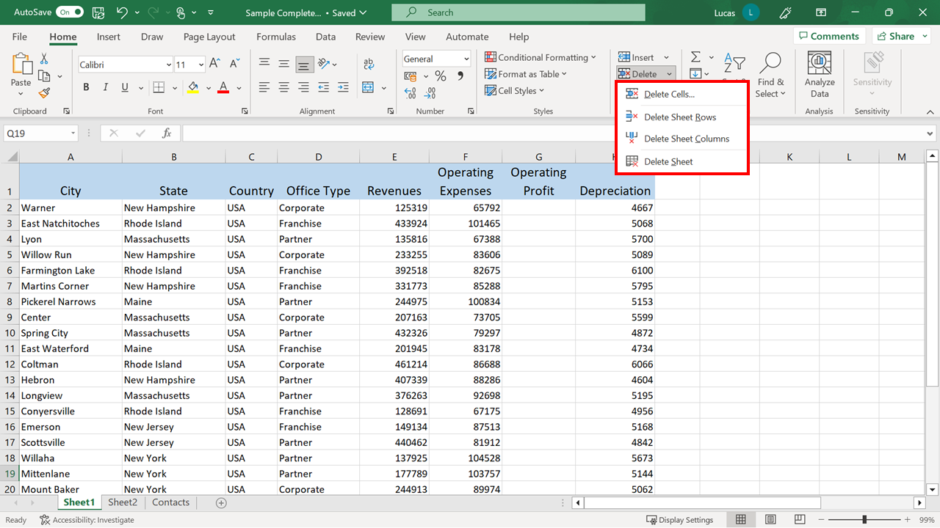
Delete columns

Slide 39
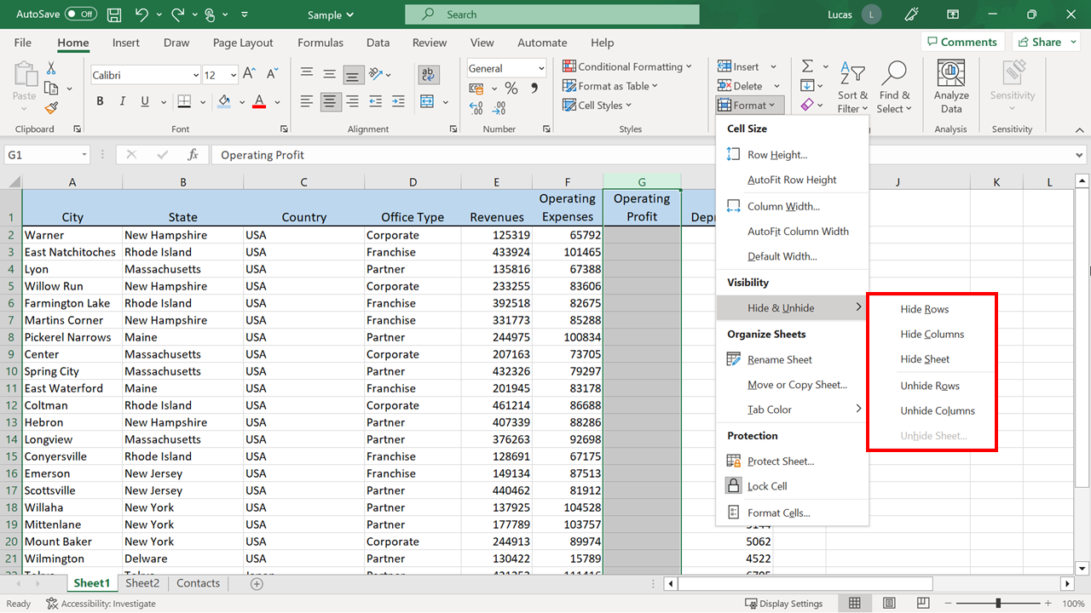
Hide and Unhide

Slide 40
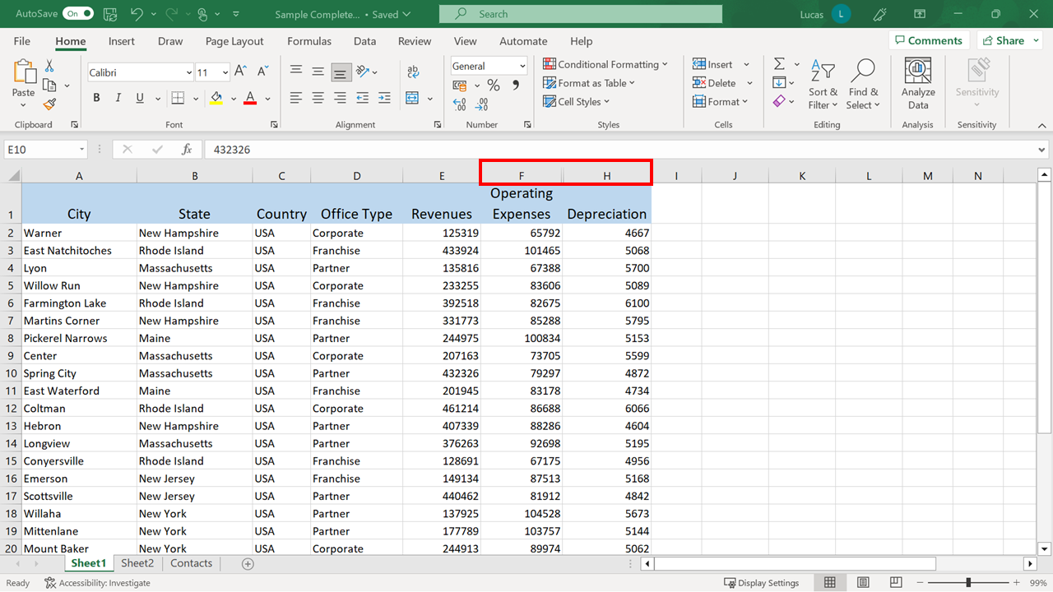
Hide and Unhide

Slide 41
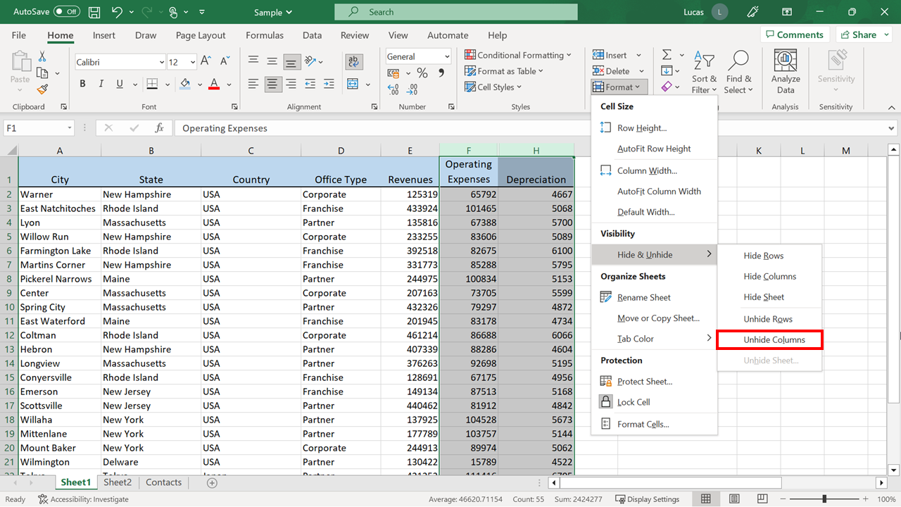
Hide and Unhide

Slide 42
4
Working with worksheets

Slide 43
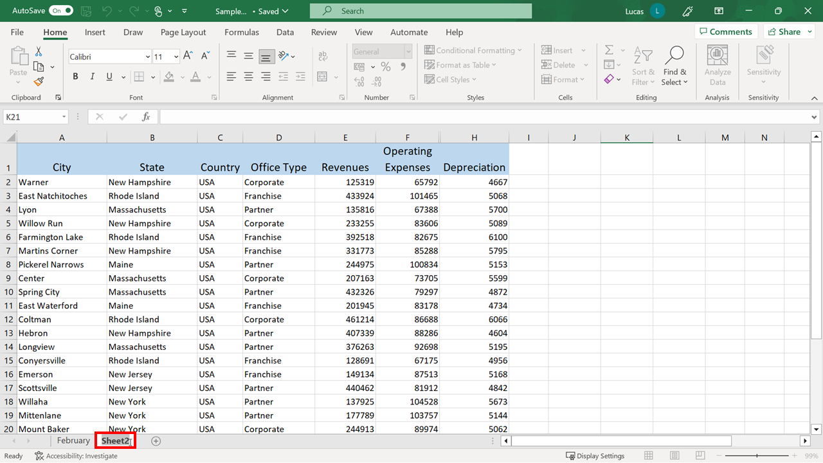
Renaming sheets

Slide 44
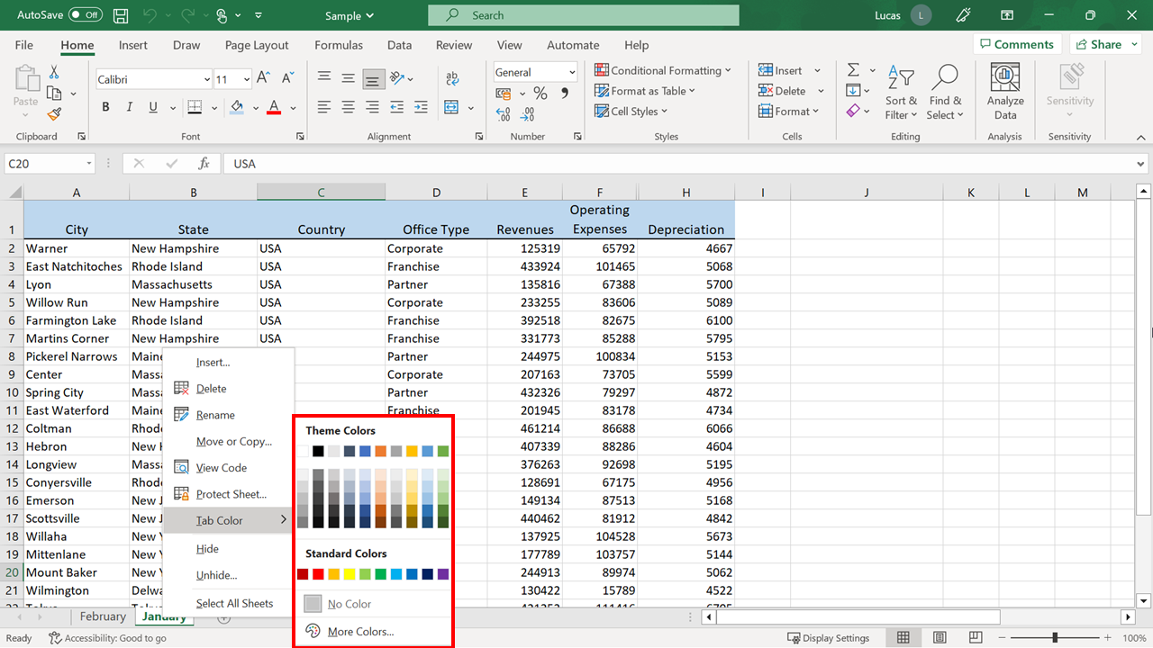
Recoloring tabs

Slide 45
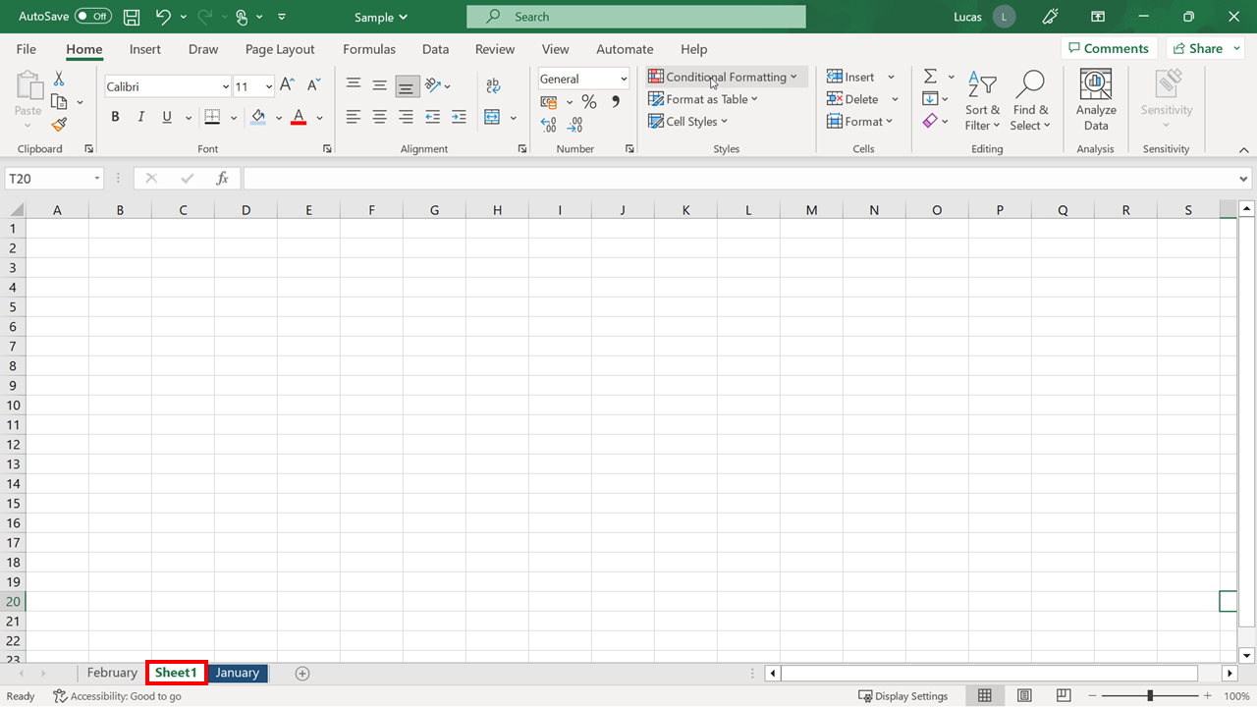
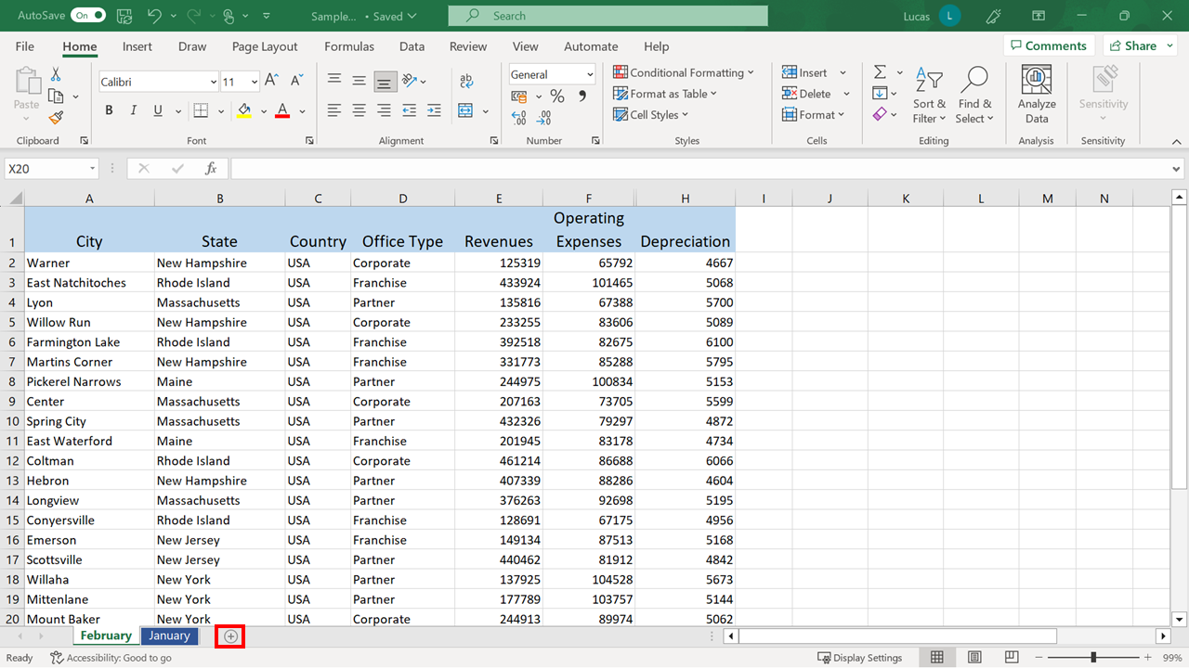
Inserting and deleting worksheets

Slide 46
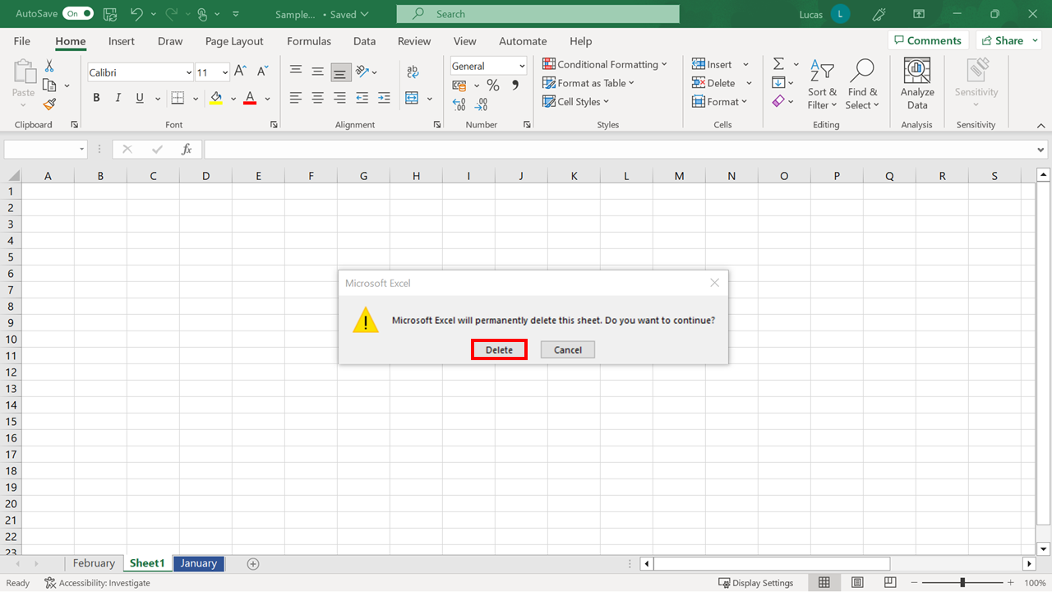
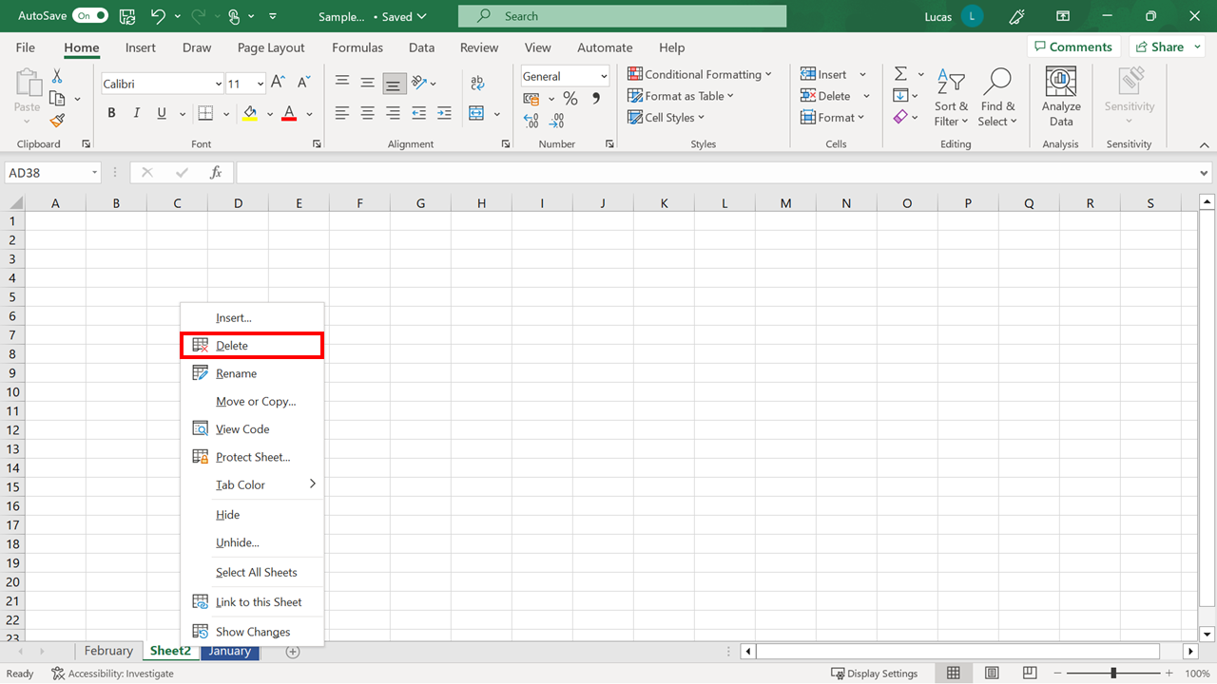
Inserting and deleting worksheets

Slide 47
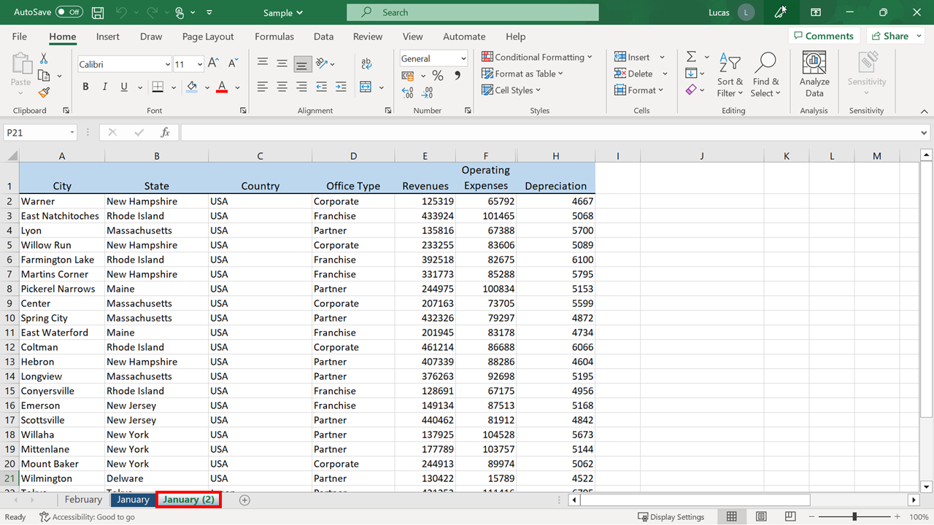
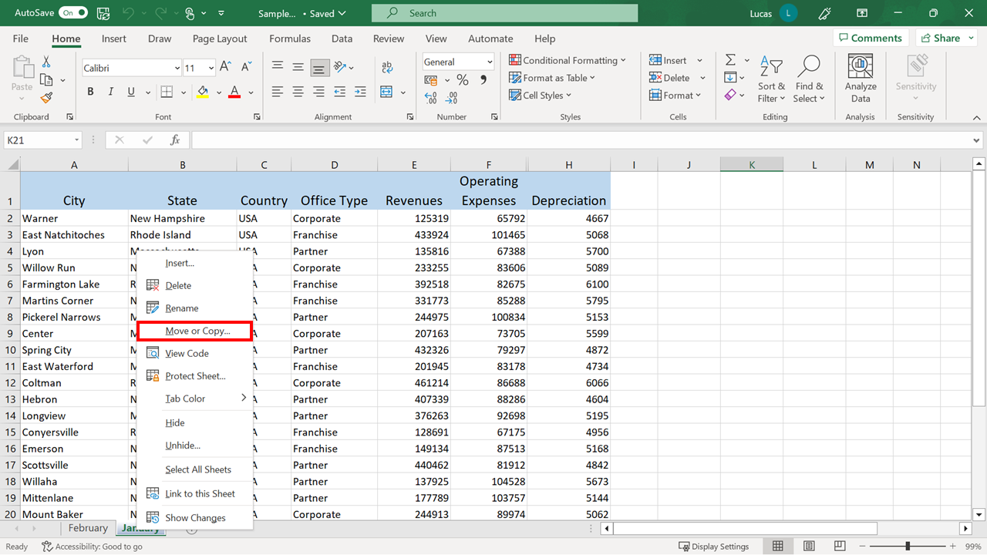
Duplicating a sheet

Slide 48
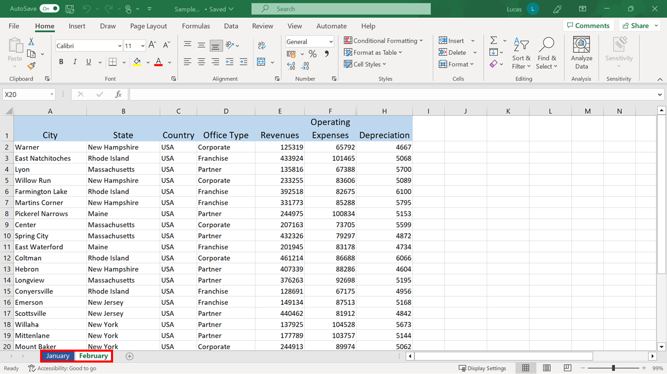
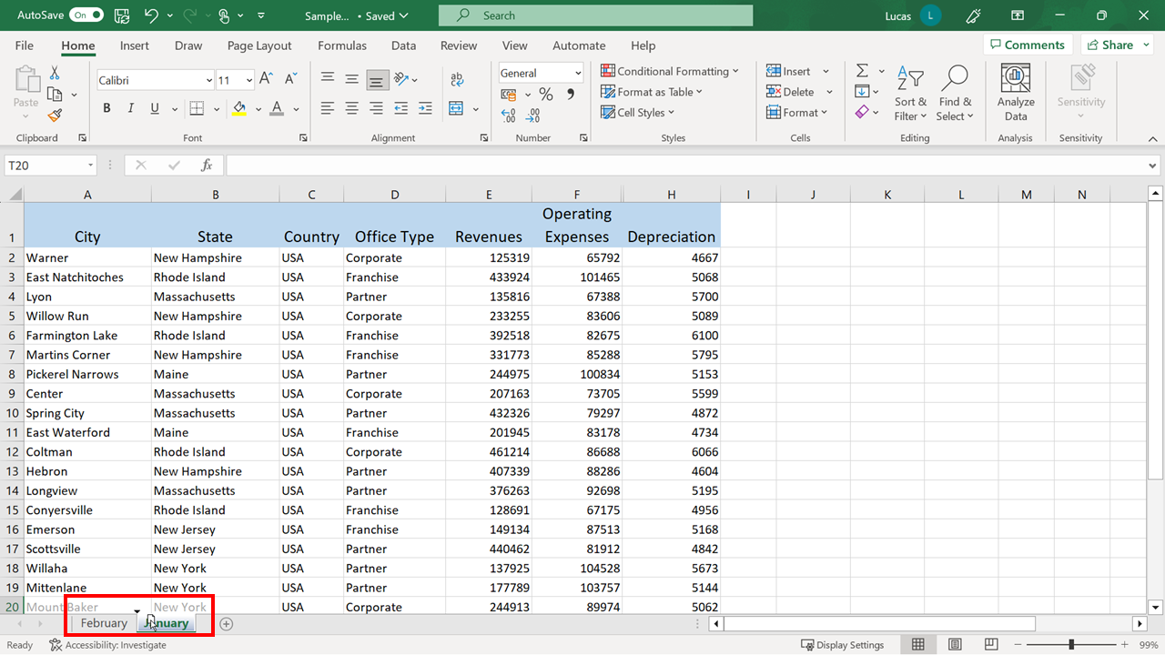
Reordering sheets in a workbook

Slide 49
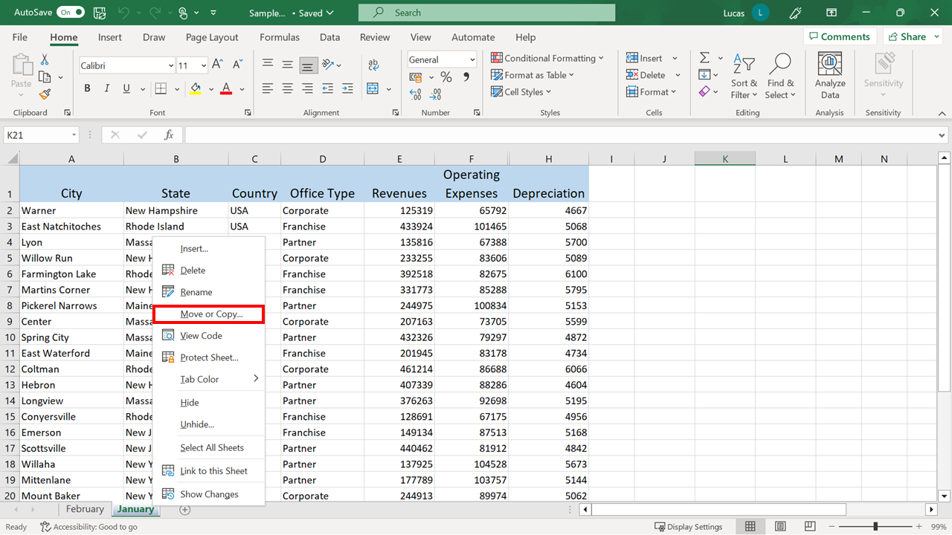
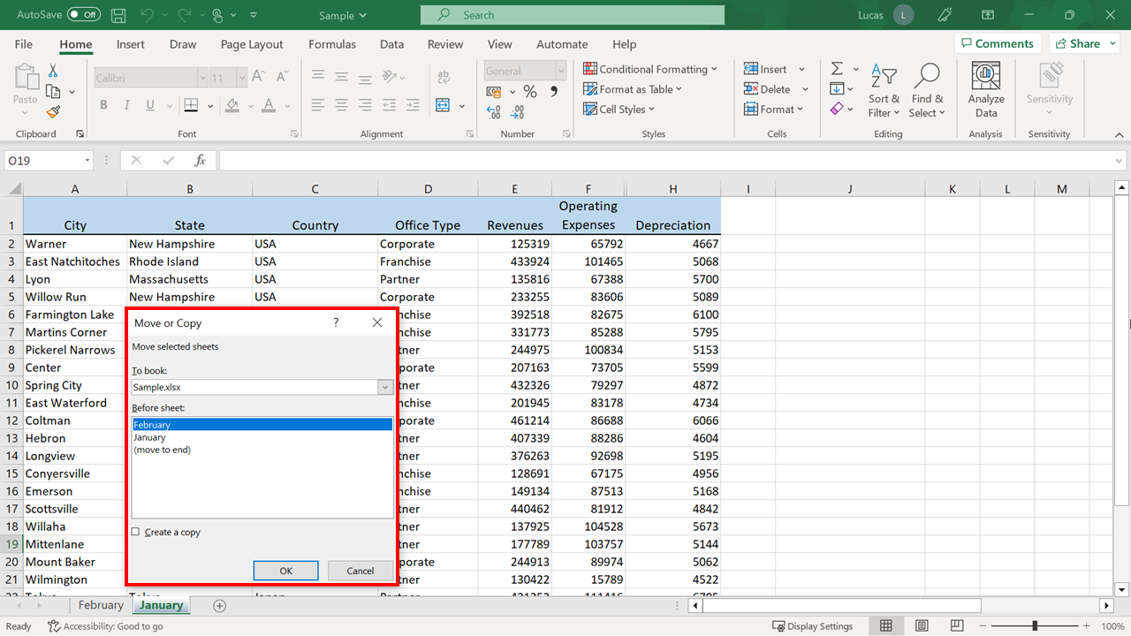
Reordering sheets in a workbook
Easier Method

Slide 50

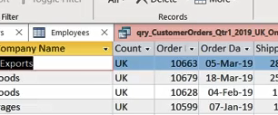
Exercise 1: Adding data to a worksheet.

Slide 51

Exercise Questions
Question 1
In Sheet1, Microsoft Excel automatically aligned a numerical entry to the left. In this case, such an action indicates an issue with the content. How can you correct an error like this?
Change the alignment.
Alter the Number format.
Edit the content.

Slide 52
Exercise Questions
Question 1
In Sheet1, Microsoft Excel automatically aligned a numerical entry to the left. In this case, such an action indicates an issue with the content. How can you correct an error like this?
Change the alignment.
Alter the Number format.
Edit the content.
If a cell contains a mixture of text and numbers, then Excel considers the entry to be text. Because of the tilde character at the beginning of the numbers, Excel recognized the contents as a text entry. To ensure the entry is recognized correctly, remove the tilde character. It then automatically re-aligns to the right as Excel now considers it numeric.

Slide 53
Exercise Questions
Question 2
In step 3, you formatted cells E23 to H25, which contained figures representing Japanese Yen amounts. What steps did you take to apply the Yen Currency format to this block of cells?
Select the Currency button in the Number section of the Home tab. Choose Accounting Formats. With Custom highlighted as a category, select the Symbol drop-down on the right. Select Japanese from the list currency symbols that appear.
Select the Currency button in the Number section of the Home tab. Choose More Accounting Formats. With Currency highlighted as a category, select the Symbol drop-down on the right. Select Japanese from the list of currencies that appear.
Select the Currency button in the Number section of the Home tab. Choose Accounting Formats. With Special highlighted as a category, select the Symbol drop-down on the right. Select Japanese from the list of currency symbols that appear.

Slide 54
Exercise Questions
Question 2
In step 3, you formatted cells E23 to H25, which contained figures representing Japanese Yen amounts. What steps did you take to apply the Yen Currency format to this block of cells?
Select the Currency button in the Number section of the Home tab. Choose Accounting Formats. With Custom highlighted as a category, select the Symbol drop-down on the right. Select Japanese from the list currency symbols that appear.
Select the Currency button in the Number section of the Home tab. Choose More Accounting Formats. With Currency highlighted as a category, select the Symbol drop-down on the right. Select Japanese from the list of currencies that appear.
Select the Currency button in the Number section of the Home tab. Choose Accounting Formats. With Special highlighted as a category, select the Symbol drop-down on the right. Select Japanese from the list of currency symbols that appear.
In the currency details screen, you can select from a list of currency symbols that list the associated countries.

Slide 55
Exercise Questions
Question 3
As one of the final steps in the exercise, you hid the Contacts worksheet using the Hide & Unhide command. Where on the Home tab is this command located?
On the Format choice in the Editing group.
On the Format choice in the Styles group.
On the Format choice in the Cells group

Slide 56
Exercise Questions
Question 3
As one of the final steps in the exercise, you hid the Contacts worksheet using the Hide & Unhide command. Where on the Home tab is this command located?
On the Format choice in the Editing group.
On the Format choice in the Styles group.
On the Format choice in the Cells group
The Format choice in the Cells group opens a drop-down menu that contains the Hide & Unhide command in a section called Visibility.

Slide 57


Slide 58


1

Slide 59

1
Explanation

Slide 60

1

Slide 61

1
Explanation

Slide 62

1

Slide 63

1
Explanation

Slide 64

1

Slide 65

1
Explanation

Slide 66

1A

Slide 67

1
Explanation

Slide 68


